Slide 1

Binning anomaly detection
Idea presentation
Gibeom Kim (UST)

Slide 2

Index
Paper abstract
Model
Result
Conclusion

Slide 3
1. Paper abstract
Based on the idea that similar image patch will show similar values and order.
Extract embedding vectors from the images, and apply binning embedding vectors
Count bins of each channels and make it possibility matrixes
Calculate how probable the test image embedding vectors are.

Slide 4
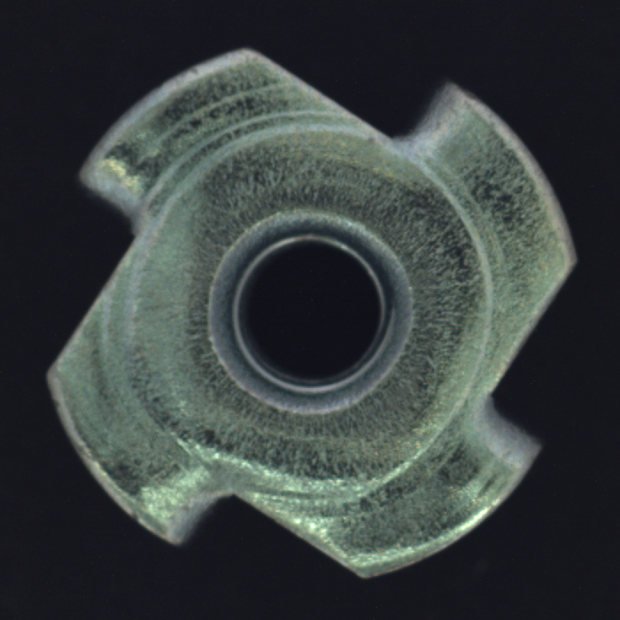
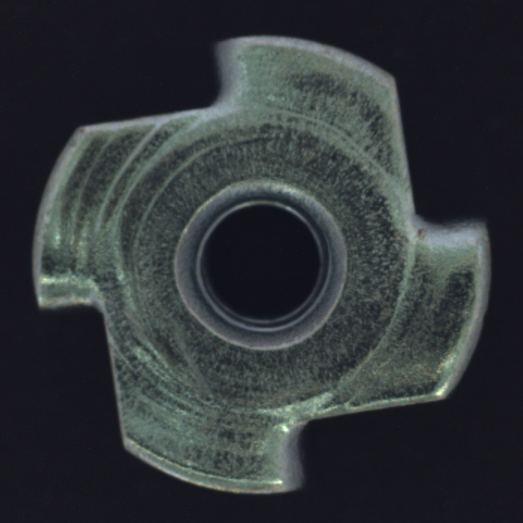
1. Paper abstract
This patch’s embedding
vectors would be similar

Slide 5
1. Paper abstract
0-th channel
1-th channel
2-th channel
3-th channel
4-th channel
0-th image
1-th image
2-th image
3-th image
4-th image
Data of Image 3 shows abnormal values
4
3
2
7
1
5
5
4
0
6
4
5
5
5
3
3
3
1
8
1
0
2
3
4
5

Slide 6
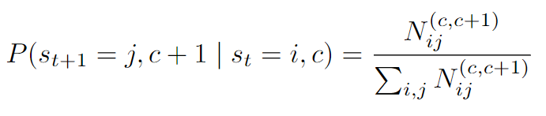
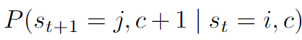
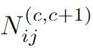
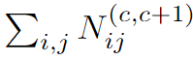
2. Model
Calculate possibility matrix
: Transition probability from state i in channel c to state j in
channel c+1
: Number of transitions from state i in channel c to state j in channel c+1
: Total number of possible transitions in channel c to c+1

Slide 7
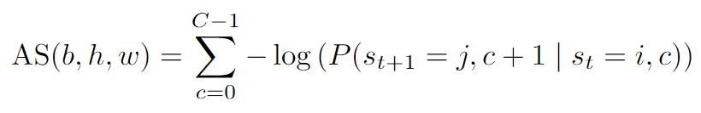
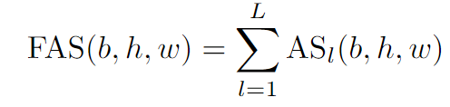
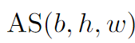
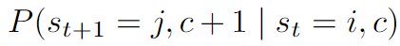
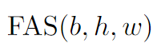
2. Model
Calculate anomaly map
: Function measuring anomality at position (b,h,w)
: Transition probability from state i in channel c to state j in
channel c+1
: Summation of , calculated from output of layers

Slide 8
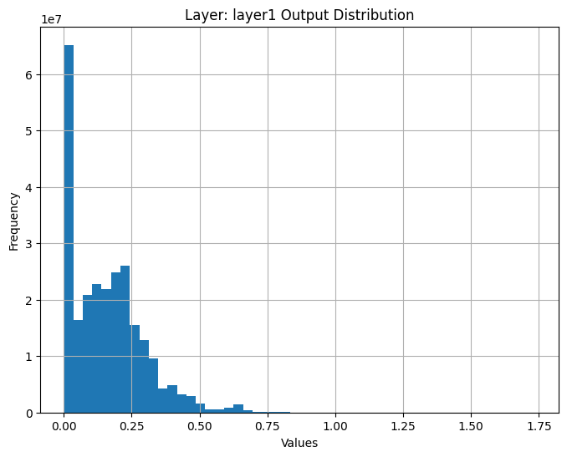
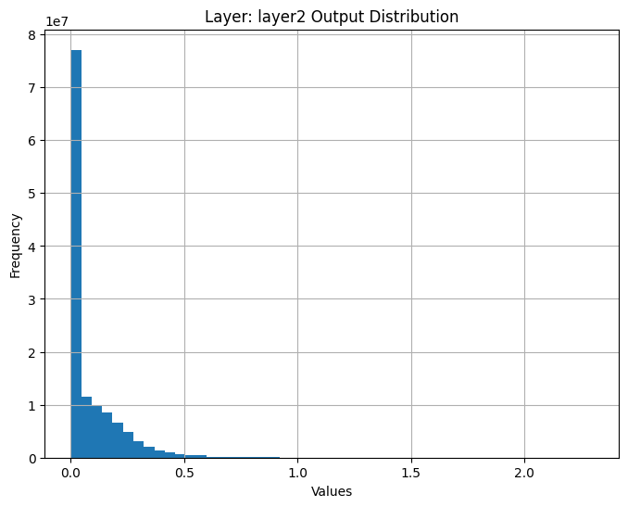
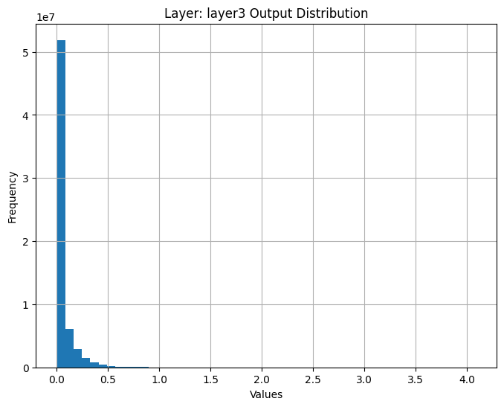
3. Result
Embedding vector data distribution
Screw

Slide 9
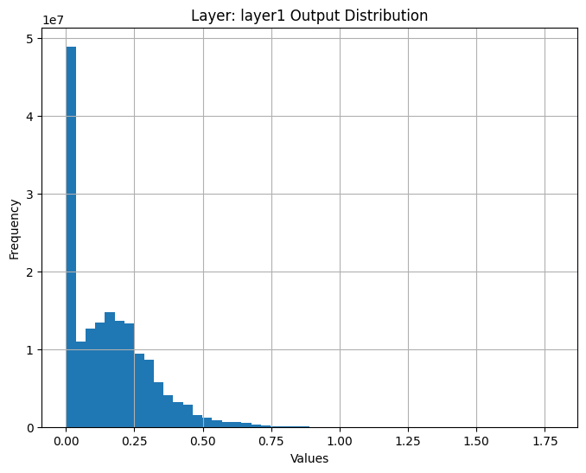

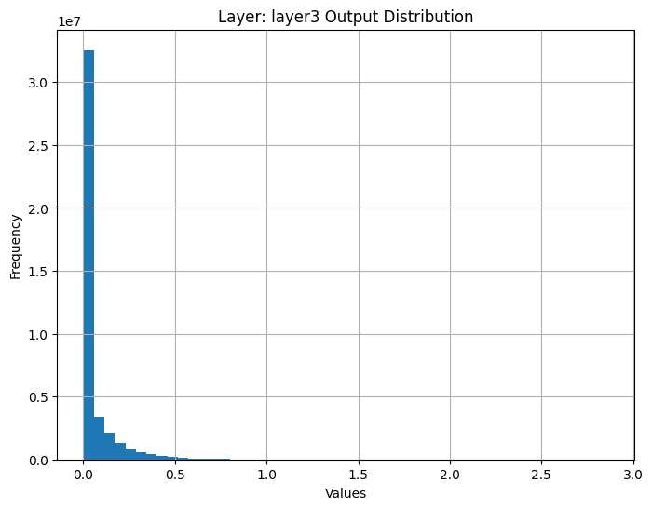
3. Result
Embedding vector data distribution
Bottle

Slide 10
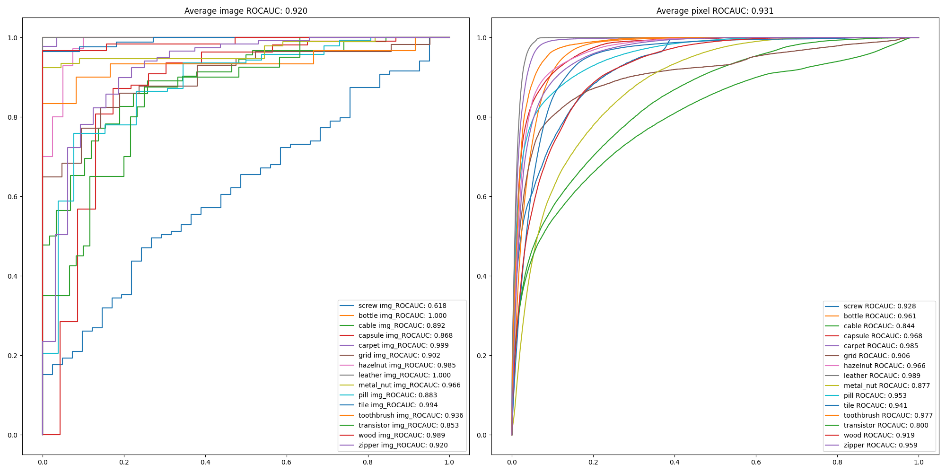
3. Result
Original result

Slide 11
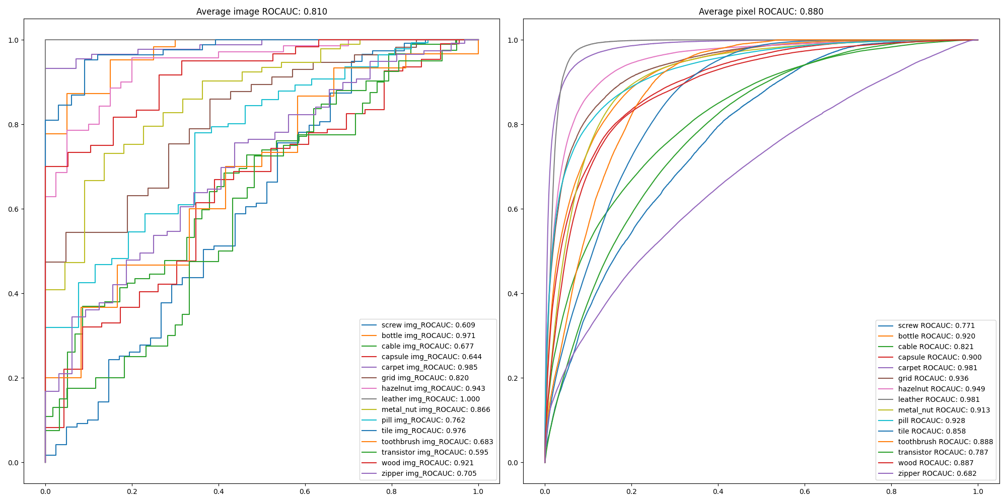
3. Result
Use ViT model

Slide 12
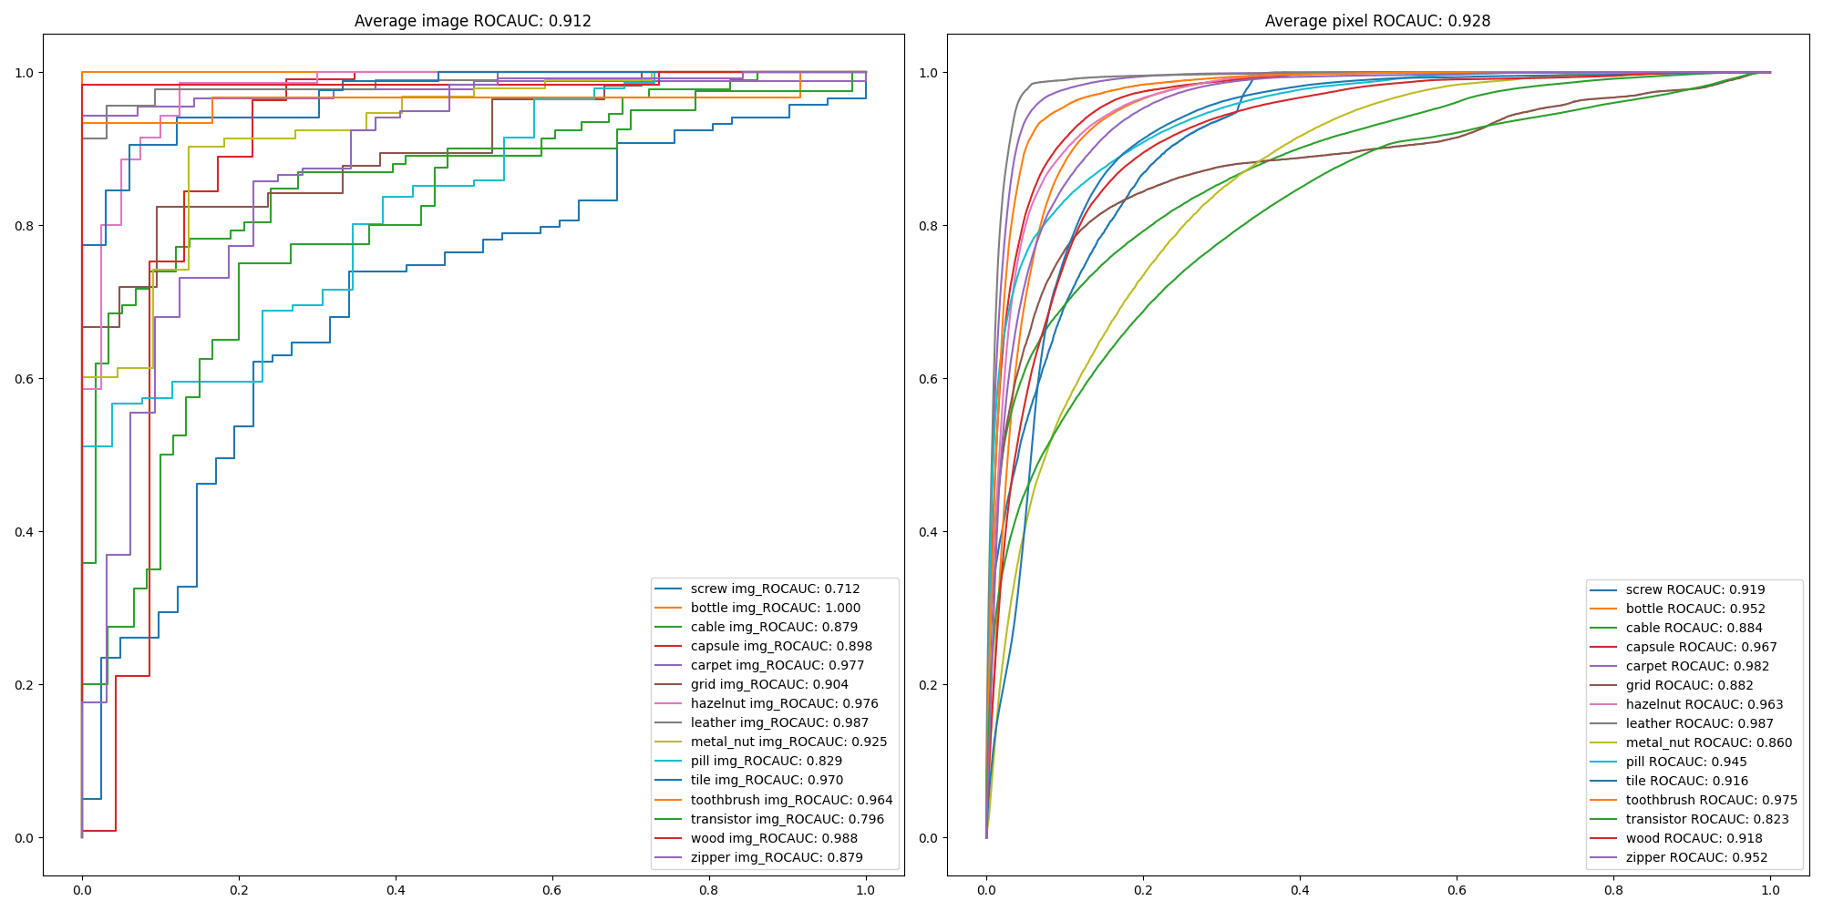
3. Result
W/O normalize image

Slide 13
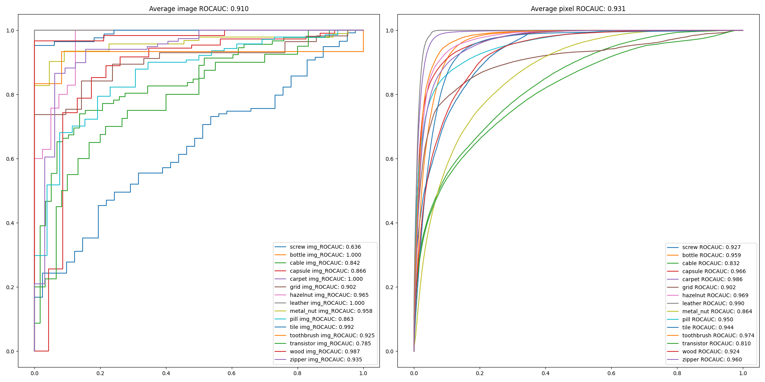
3. Result
Binning method 1 result , w/o normalize image np.histogram(flattened_vectors, bins=num_bins)

Slide 14
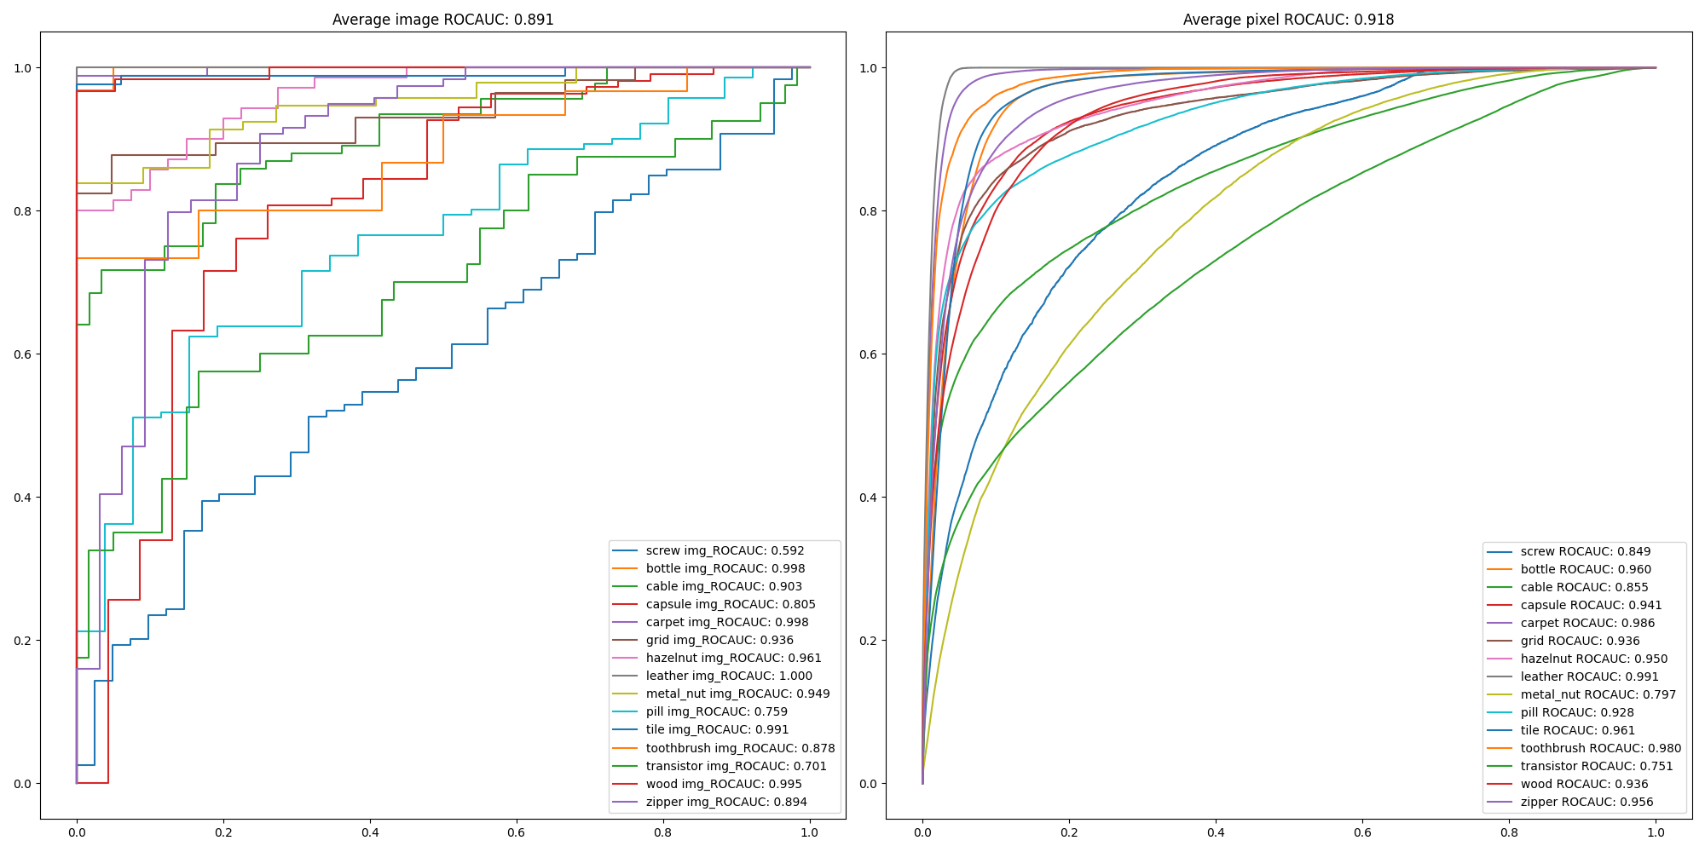
3. Result
Binning method 2 result, w/o normalize image percentiles = np.linspace(0, 100, num_bins + 1) bin_edges = np.percentile(flattened_vectors, percentiles)

Slide 15
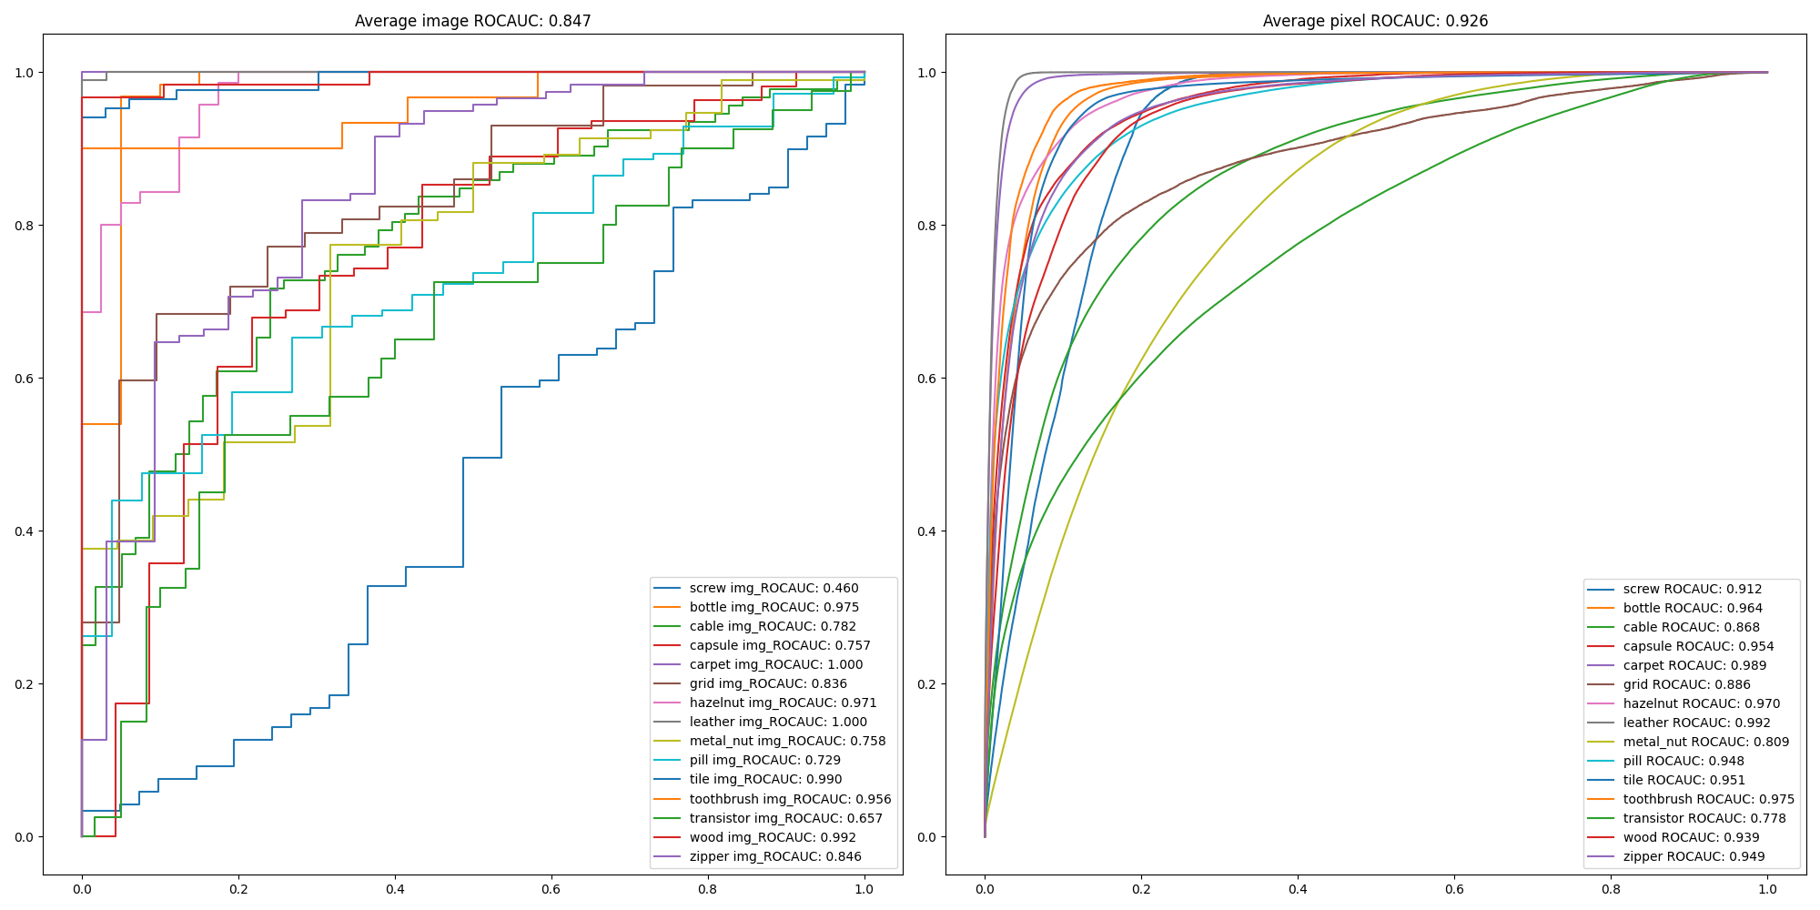
3. Result
Binning method 3 result, w/o normalize image state_bins = np.arange(0, 3.1, 0.1)

Slide 16
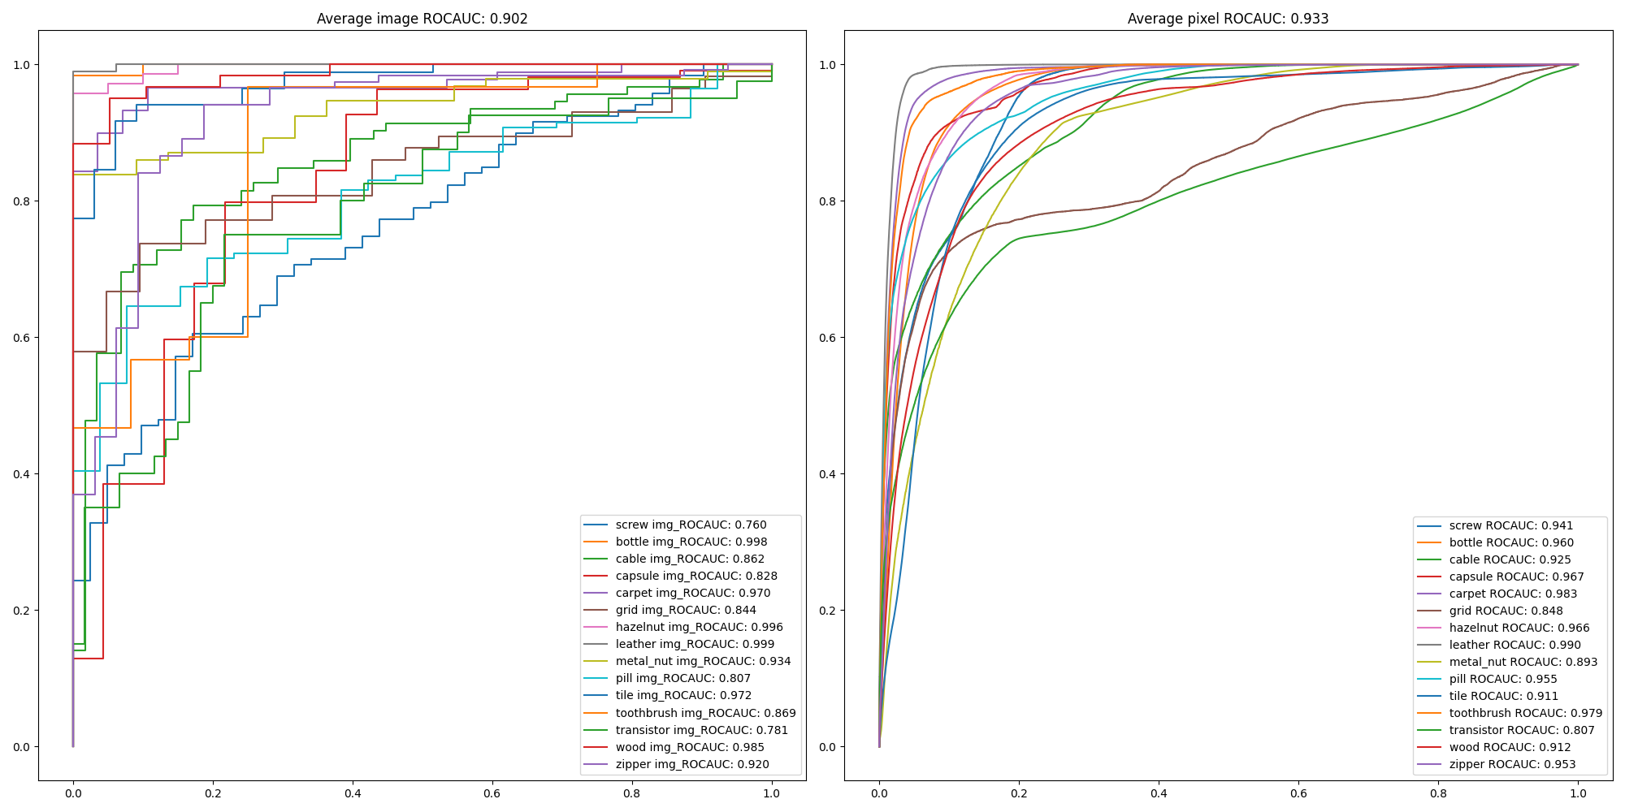
3. Result
Apply tolerance 1 to to calculate anomaly map lower_bounds = np.maximum(next_states - tolerance, 0) upper_bounds = np.minimum(next_states + tolerance, num_states - 1)

Slide 17
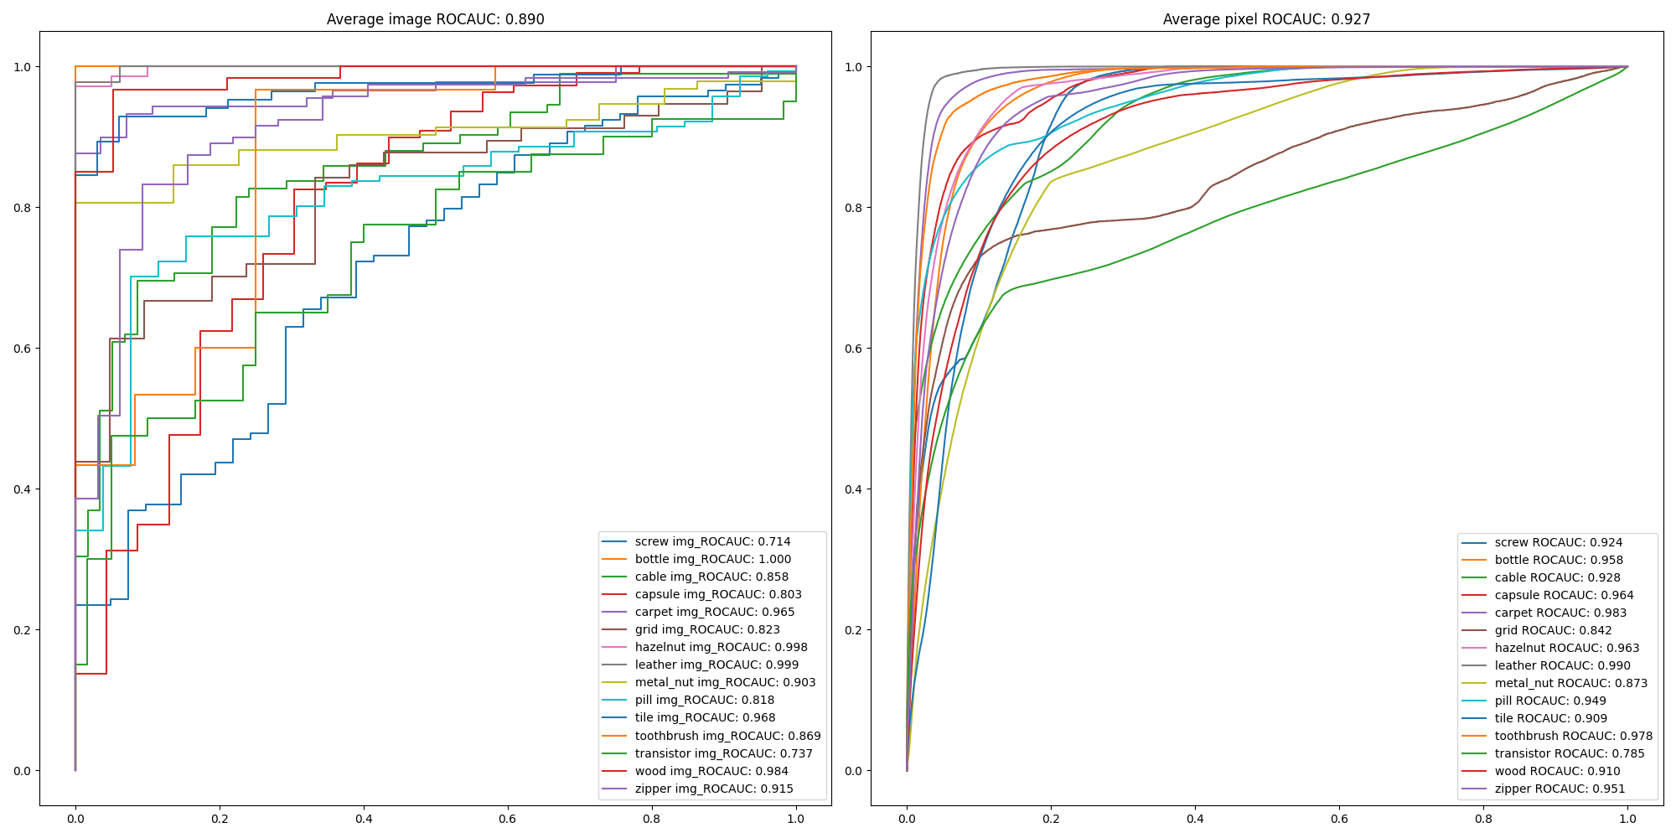
3. Result
Apply tolerance 2 to calculate anomaly map lower_bounds = np.maximum(next_states - tolerance, 0) upper_bounds = np.minimum(next_states + tolerance, num_states - 1)

Slide 18
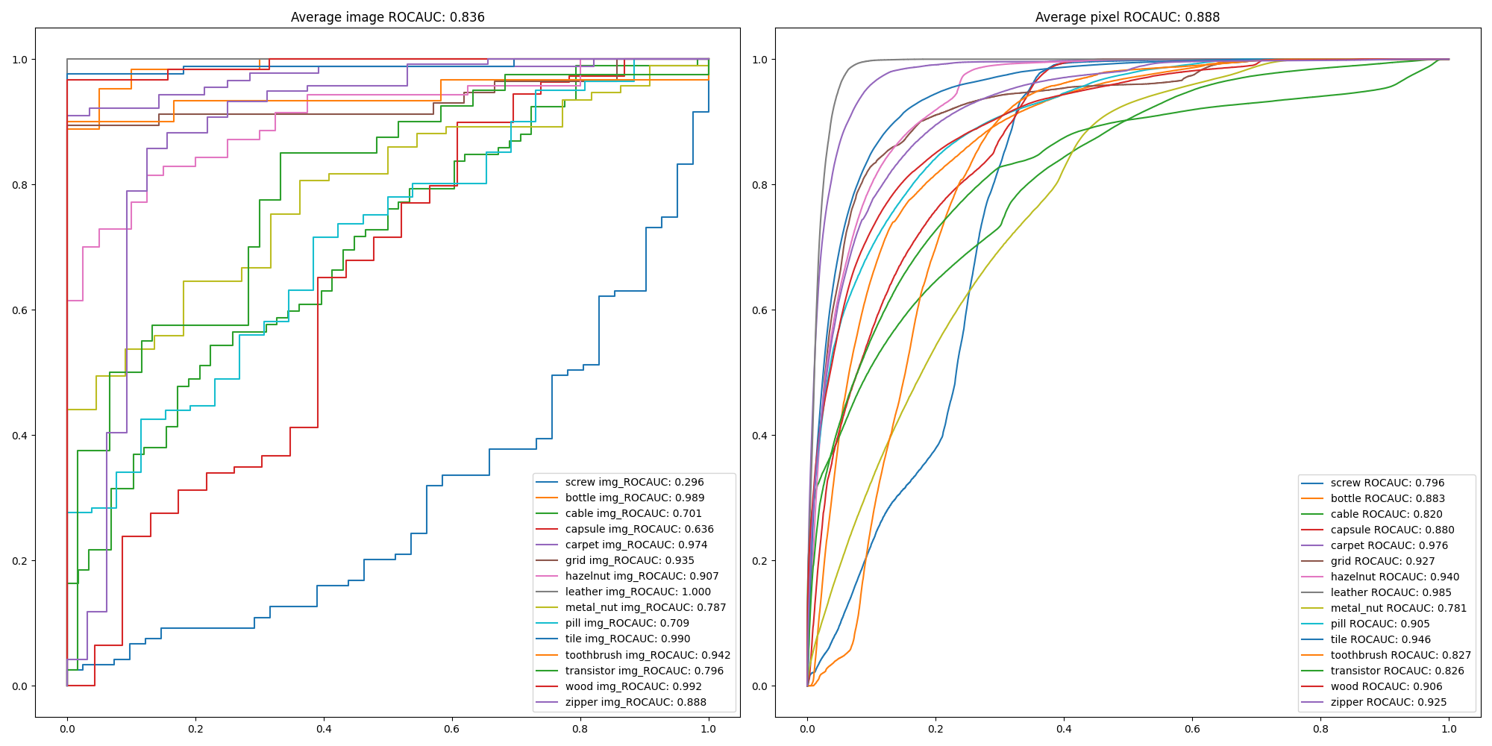
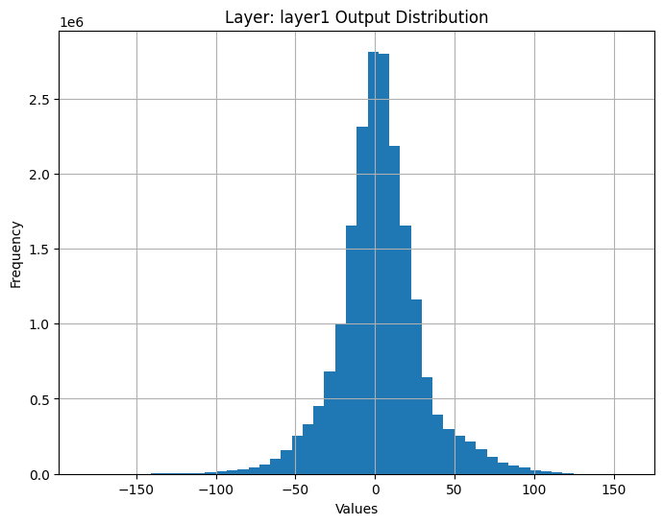
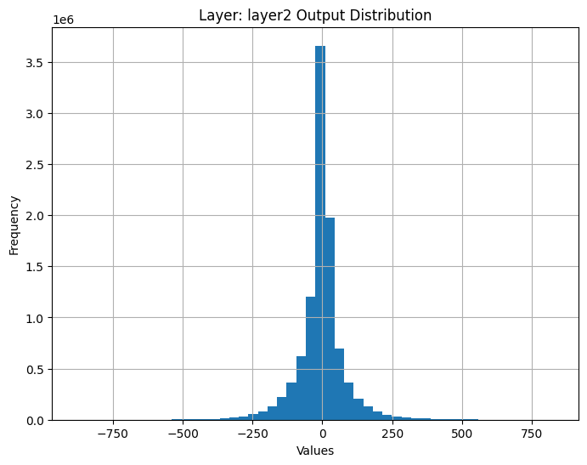
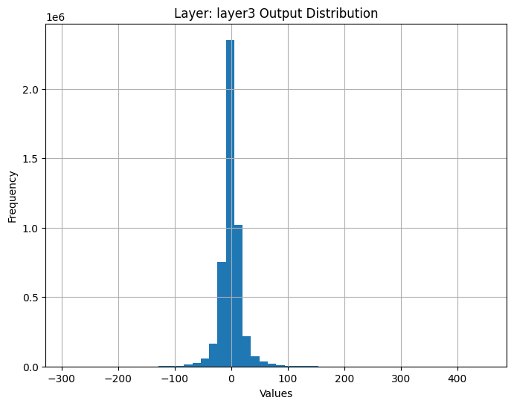
3. Result
Binning method 1 result + Use Efficientnet

Slide 19
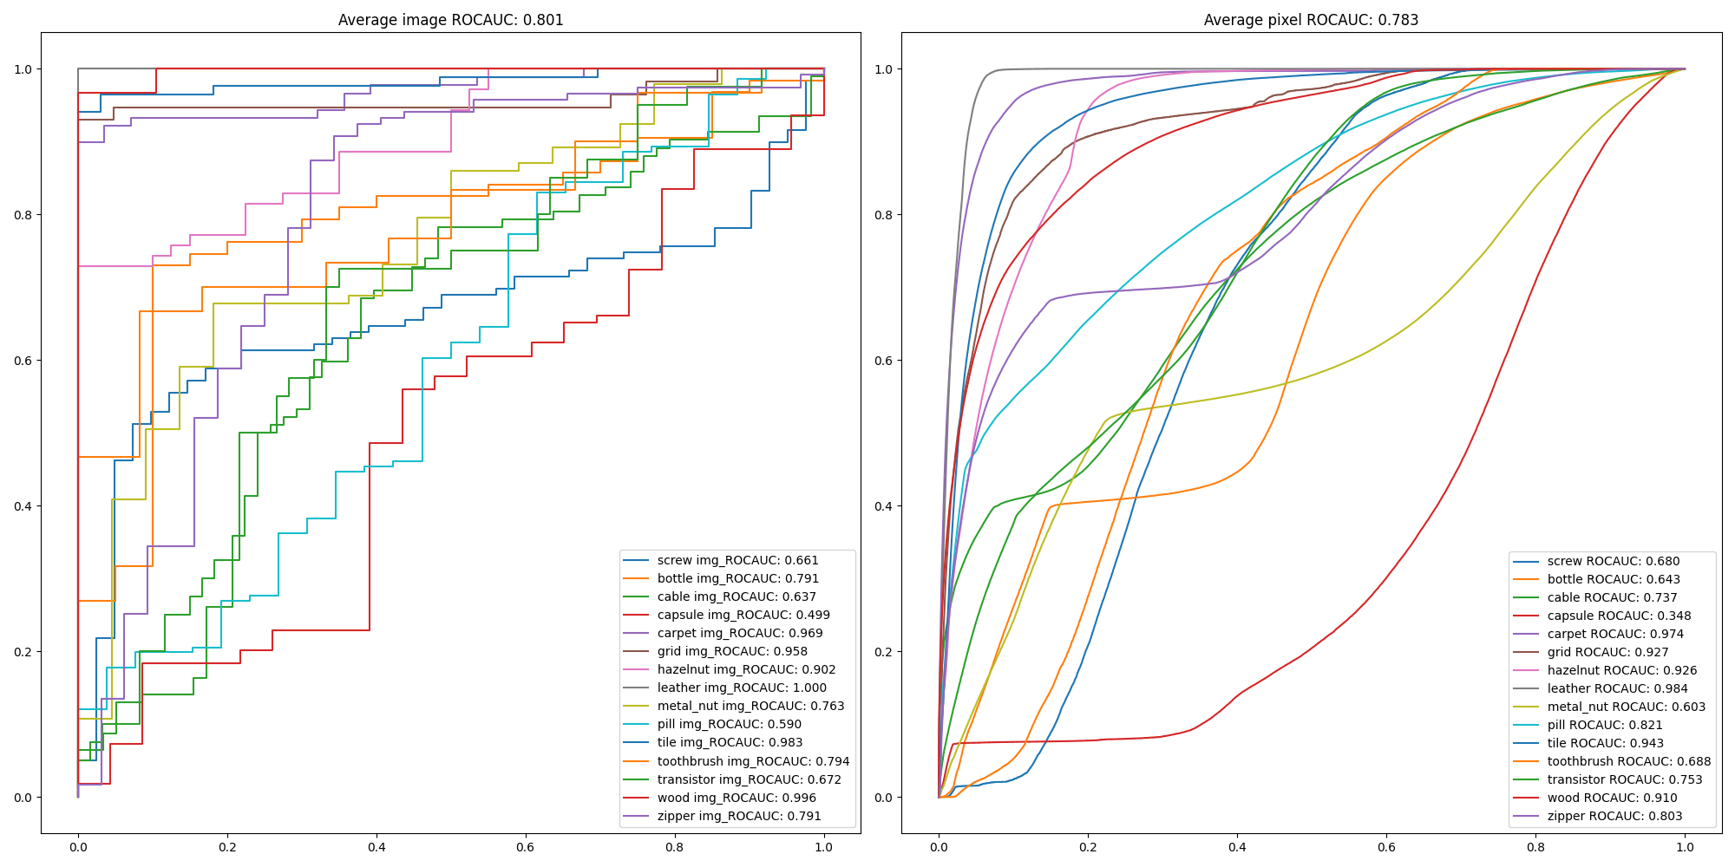
3. Result
Binning method 2 result + Use Efficientnet

Slide 20
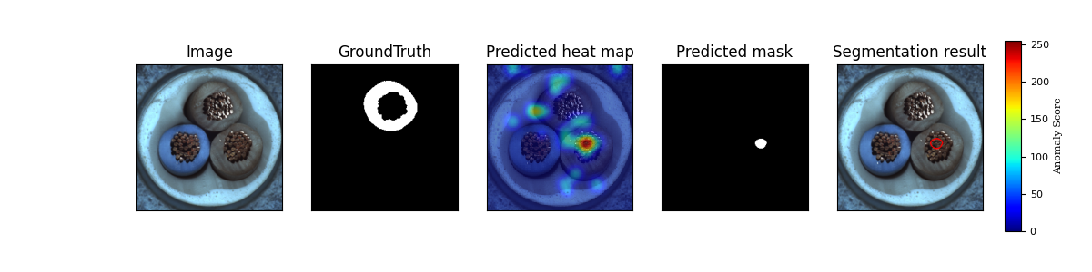
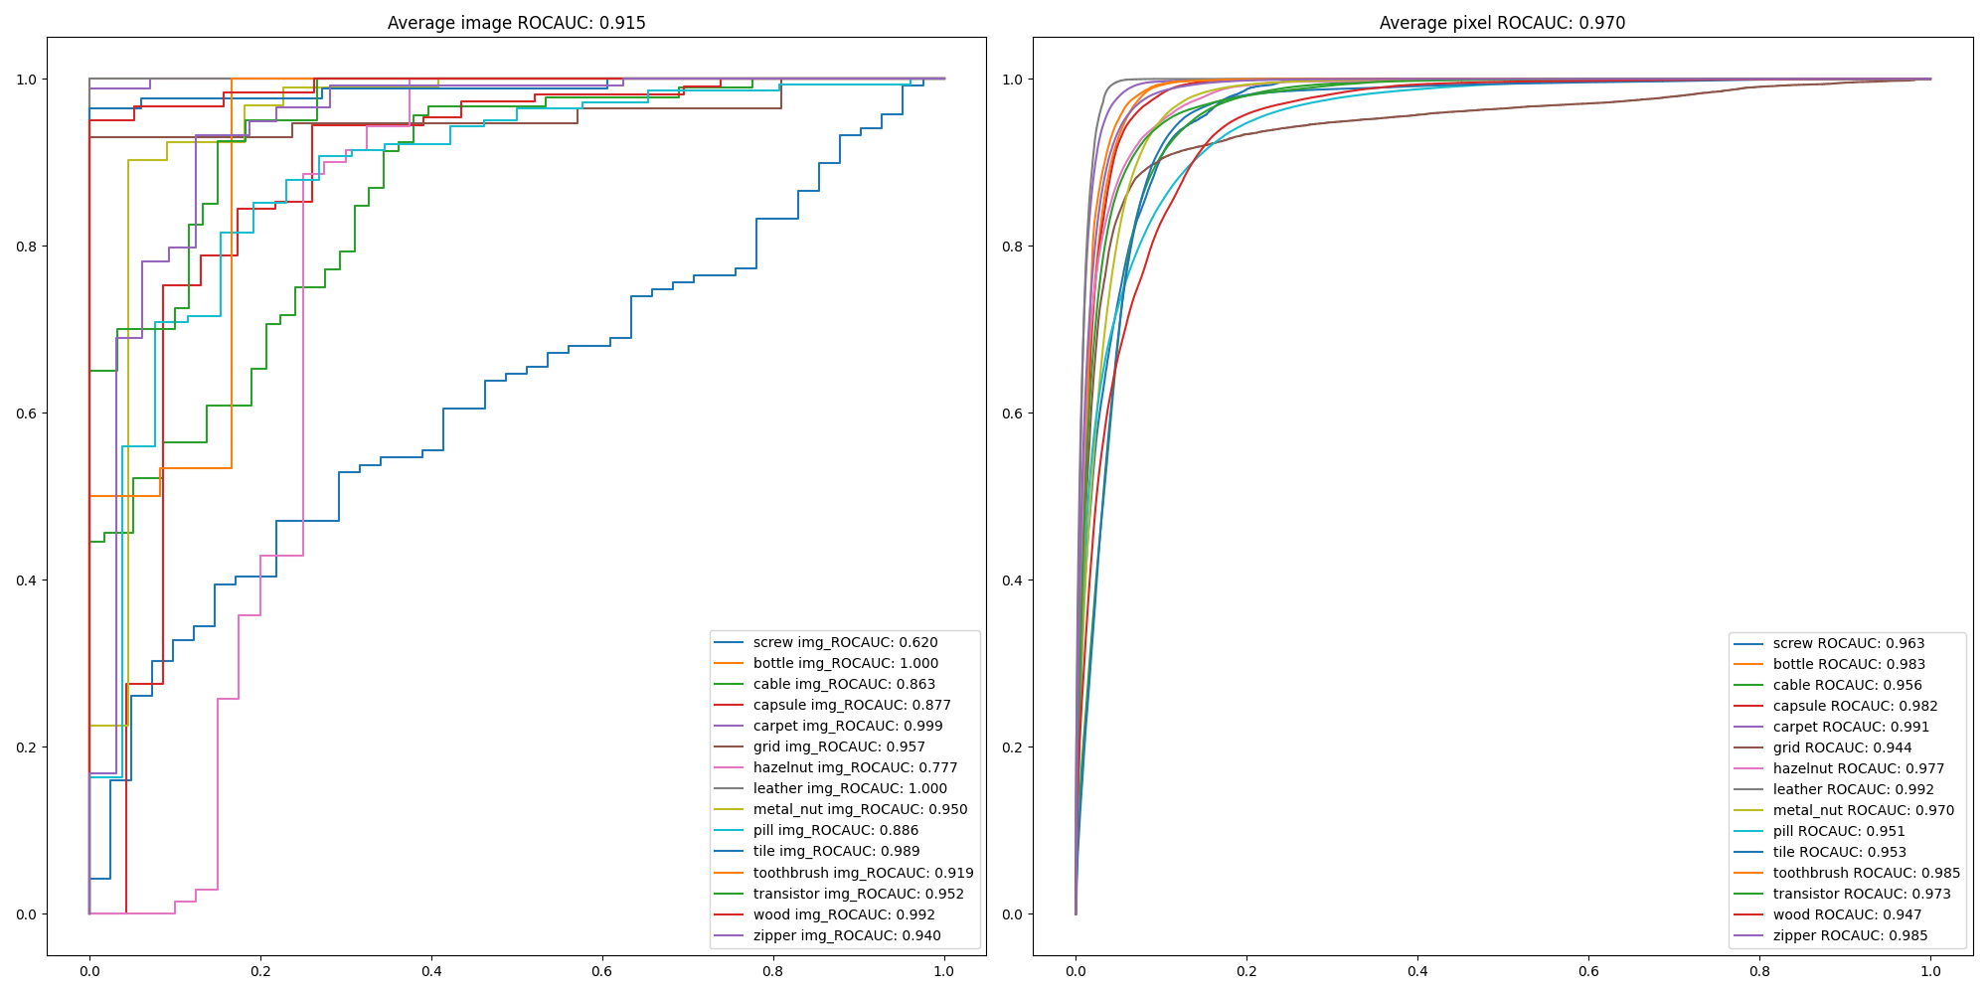
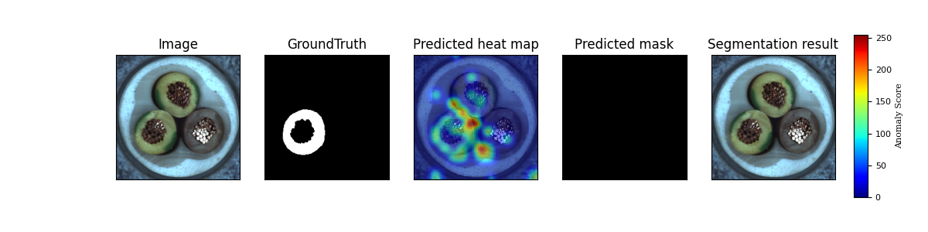
3. Result
Apply position transition matrix additionally

Slide 21
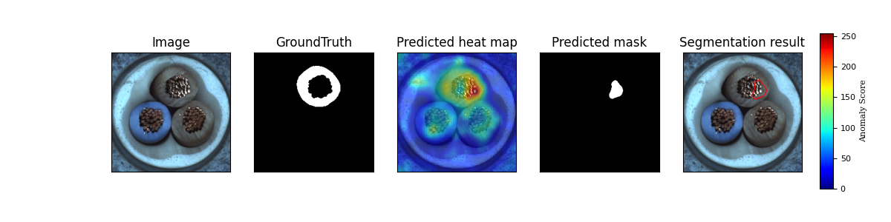
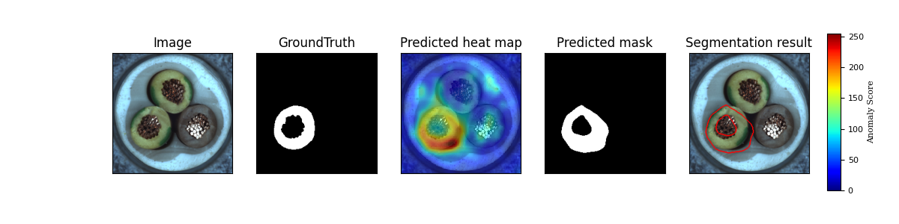
3. Result
Apply position transition matrix additionally

Slide 22
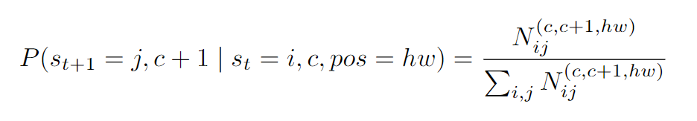
2. Model
Apply position transition matrix additionally
: Transition probability from state i in channel c to state j in channel c+1 at position ℎ𝑤
: Number of transitions from state i in channel c to state j in channel c+1 at position ℎ𝑤
: Total number of possible transitions in channel c to c+1 at position ℎ𝑤

Slide 23
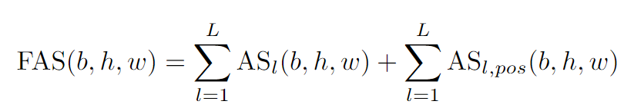
2. Model
Apply position transition matrix additionally
: Function measuring anomality at position (b,h,w)
: Transition probability from state i in channel c to state j in
channel c+1
: Summation of , calculated from output of layers

Slide 24
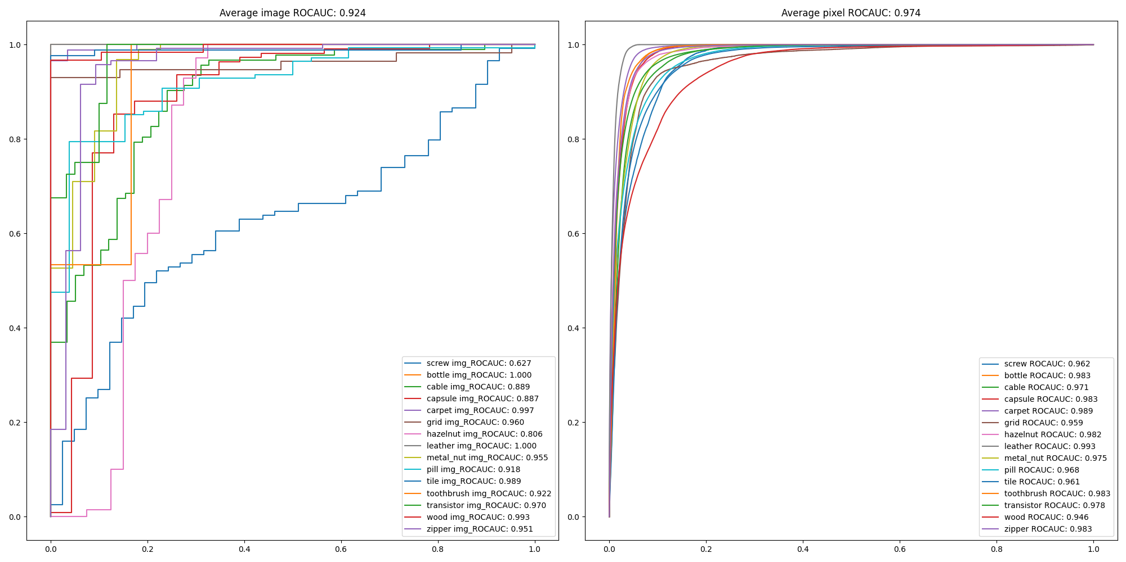
3. Result
Apply position transition matrix additionally(Wide_Resnet101)

Slide 25
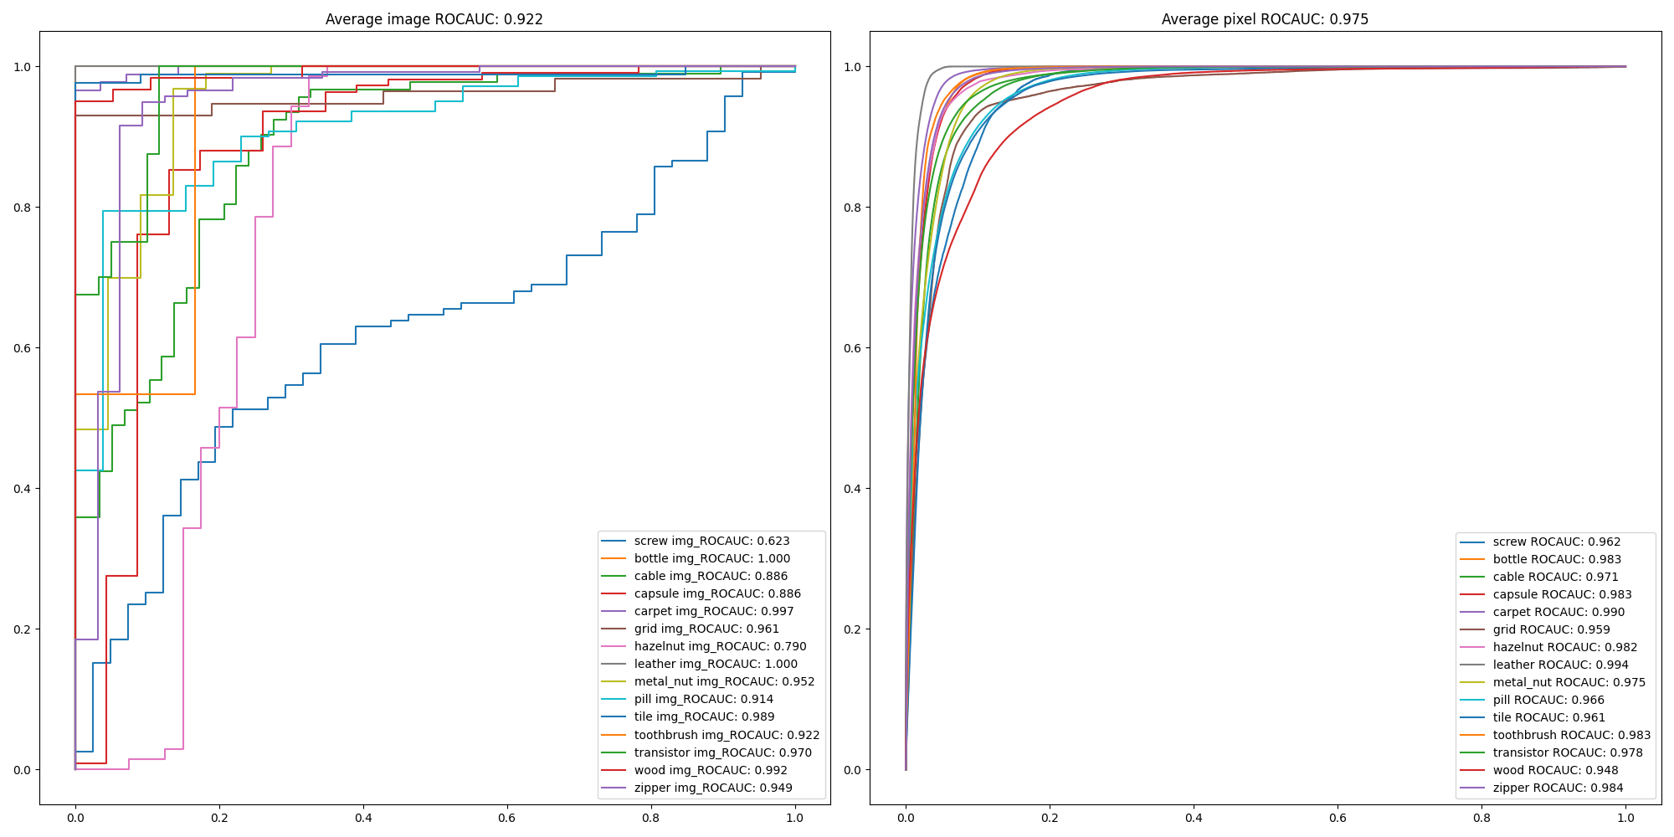
3. Result
Apply position transition matrix only(Wide_Resnet101)

Slide 26
4. Conclusion
<To Do>
Improve training algorithm to calculate it faster.
Improve ROCAUC score (ex, use other large pretrained model such as wide_resnet101_2, combine methods that have shown good results)
<Contirubution>
Another method for anomaly detection task
Fast training, Fast inference
Acceptable image score and pixel score
Easily can be applied to large dataset
| feature extraction | train | carpet |: 89%|█████████████████████████████████████████████████████████████████████████████████▊ | 8/9 [00:14<00:01, 1.82s/it]c:\Users\USER\Desktop\수업\논문\code\.venv\Lib\site-packages\torch\nn\modules\conv.py:456: UserWarning: Plan failed with a cudnnException: CUDNN_BACKEND_EXECUTION_PLAN_DESCRIPTOR: cudnnFinalize Descriptor Failed cudnn_status: CUDNN_STATUS_NOT_SUPPORTED (Triggered internally at ..\aten\src\ATen\native\cudnn\Conv_v8.cpp:919.)
return F.conv2d(input, weight, bias, self.stride,
| feature extraction | train | carpet |: 100%|████████████████████████████████████████████████████████████████████████████████████████████| 9/9 [00:15<00:00, 1.77s/it]
Calculating Transition Matrices: 100%|█████████████████████████████████████████████████████████████████████████████████████| 3672000/3672000 [02:03<00:00, 29682.45it/s] transition_matrices[c] /= transition_matrices[c].sum(axis=1, keepdims=True)
Calculating Transition Matrices: 100%|█████████████████████████████████████████████████████████████████████████████████████| 1839600/1839600 [00:46<00:00, 39578.12it/s]
Calculating Transition Matrices: 100%|███████████████████████████████████████████████████████████████████████████████████████| 920700/920700 [00:22<00:00, 40901.68it/s]
| feature extraction | test | carpet |: 100%|█████████████████████████████████████████████████████████████████████████████████████████████| 4/4 [00:07<00:00, 1.80s/it]
Calculating Distance Matrix: 0%| | 0/429624000 [00:00<?, ?it/s]C:\Users\USER\Desktop\수업\논문\code\test24.py:89: RuntimeWarning: divide by zero encountered in log
log_probs = -np.log(probs)
Calculating Distance Matrix: 100%|█████████████████████████████████████████████████████████████████████████████████| 429624000/429624000 [00:02<00:00, 172012019.41it/s]
Calculating Distance Matrix: 100%|█████████████████████████████████████████████████████████████████████████████████| 215233200/215233200 [00:01<00:00, 143781094.85it/s]
Calculating Distance Matrix: 100%|██████████████████████████████████████████████████████████████████████████████████| 107721900/107721900 [00:01<00:00, 89403308.87it/s]
image ROCAUC: 0.976
pixel ROCAUC: 0.986

Slide 27
Thank you

